Slide 1
Introduction to Object Oriented Programming

Slide 2
Overview
What is a class?
Class syntax
What is an object?
Class and Object (Exercise)
Class constructor
Class constructor example
Constructor (exercise)
Object composition

Slide 3
What is a class?
A class can be defined as a template/blueprint for creating objects.
Describes the behavior and state that objects of its type support.
A class is the blueprint from which individual objects are created.
Individual objects are created using the ‘new’ keyword.
A class defines a new data type which can be used to create objects of that type.
A class is a template for an object, and an object is an instance of a class.

Slide 4
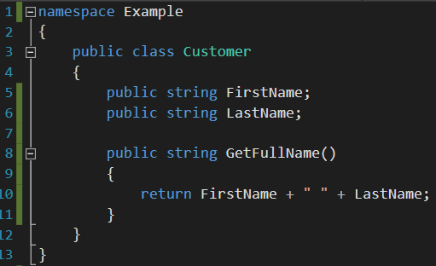
Class syntax
Namespace keyword
Current namespace name
Class definition keyword
Class name (identifier)
Class access modifier
Data members/member variables/
instance variables/property values/
fields
Member access modifier
Member functions/methods

Slide 5
What is an object?
A Object is a instance of a class.
Has the behavior and state of a class.
An instance is an object in memory
Objects allows the use of instance state to be used inside of function members/class methods.
This allows the use of encapsulation.
Results in more stable code that is easier to maintain and use.

Slide 6
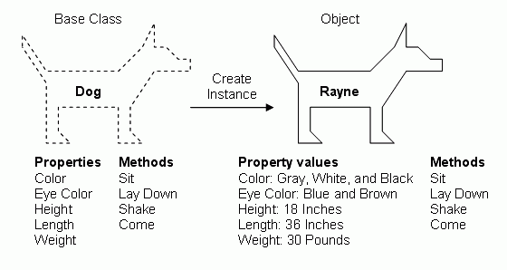
Class and Object (Exercise)

Slide 7
Class Constructor
Defines a state contract for the class
Constructor declaration looks like method declarations – except they use the name of the class and have no return type.

Slide 8
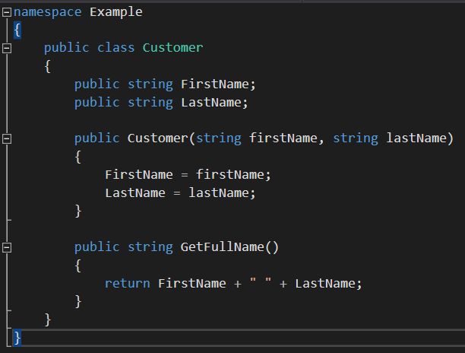
Class Constructor Example
Constructor parameters
Constructor access modifier
Constructor name
(same name as the class)

Slide 9
Constructor (Exercise)
Take the Dog class from before and make use of a class constructor.
Make it so the following instance variables are being set in the constructor:
Color
Eye Color
Height
Length
Weight

Slide 10
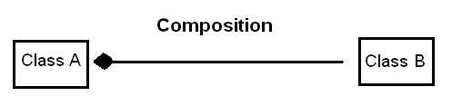
Object composition
A way to combine simple objects or data types into complex types.
Composite types
Non-composite types

Slide 11
Summary
Class
A template/blueprint to create an object of the type of the class.
A class defines instance variables and member functions/class methods
Object
An object is an instance of a class.
Holds state and behavior of a class.
An object stores its state in its instance variables and exposes its behavior through methods.
Instance
An instance is a unique copy of a Class.
Represents an Object.
When a new instance of a class is created memory is allocated for that class instance.
Constructor
Defines a state contract for the class
Looks like method declarations – except they use the name of the class and have no return type.

